Slide 1


Slide 2
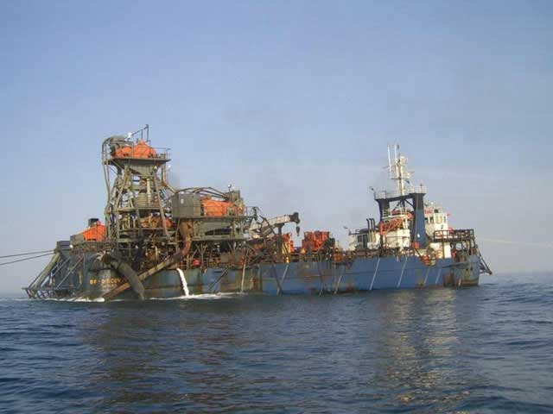
Future Aspects of Marine Mining

Slide 3
The marine diamond deposits of southern Africa owe their existence to fluvial transport down the Orange River to the South Atlantic. On the coast, they were moved, sorted and concentrated by high-energy sea and wind conditions to create a veneer of diamondiferous gravels on the sea floor.

Slide 4
Two important developments have occurred recently. Firstly, equipment for the recovery of diamonds from the seabed has been successfully borrowed from other industries. Large drills from onshore civil engineering have been modified for marine sampling and mining. Remotely controlled, seabed-mounted, excavational systems have assumed a major role. The new systems allow both evaluation sampling and subsequent mining to be undertaken by similar or the same equipment, making the results compatible. They permit highly selective extraction and enhanced recovery of the gravels from irregular bedrock in water approaching 200 m deep.

Slide 5
DBM GEOSURVEY is the marine survey arm of De Beers Marine, the world’s largest marine precious mineral mining company. DBM GEOSURVEY has pioneered the development of geophysical survey systems over the past 20 years to improve mineral resource development and support DBM’s mining activities. Core to this development was the decision to adopt autonomous underwater vehicles (AUVs) as the primary survey platform. We look back on the challenges and successes of 7 years of AUV operations.

Slide 6
The majority of offshore diamond mining activity occurs off the west coast of Namibia and South Africa in the middle shelf region (an area 5 to 150km from the coast in water depths from 70 to 200m), and hence this is the area where the majority of geosurvey work is carried out.

Slide 7
The unique potential of AUVs as survey platforms offered the ­possibility of higher resolution and higher precision survey and the capability to host new and enhanced geophysical sensors. Namibian Marine Deposits The marine phosphate deposit Bonaparte is working occurs as nodules of fine-grain sized sand particles at depths ranging between 150-300 metres seawater.

Slide 8
The unique potential of AUVs as survey platforms offered the ­possibility of higher resolution and higher precision survey and the capability to host new and enhanced geophysical sensors. Namibian Marine Deposits The marine phosphate deposit Bonaparte is working occurs as nodules of fine-grain sized sand particles at depths ranging between 150-300 metres seawater.

Slide 9
Bonaparte’s initial exploration target‡ in the Meob project area is to define 40 to 50 million tonnes at an average grade between 10% and 15% P2O5 prior to enrichment.

Slide 10
The company is applying to the Namibian Ministry of Mines and Energy for an additional nine licenses covering a 9,000 square kilometre area.

Slide 11
“These particular areas are going to be approximately 40 kilometres off the coast in an environment where operations have been ongoing in the marine diamonds industry for many years now so the operational environments are very well understood,” Woodborne said in an interview with Sydney’s Boardroom Audio.

